Slide 1
Utility Optimization for Event-Driven Distributed Infrastructures
Steven Lai

Slide 2
Motivation - Trade Data
2 types of users
  Gold users: pay for the data.
  Public users: don’t pay for the data.
  In case of lack of resources, load can be reduced by denying services to public users

Slide 3
Motivation – Latest Price Data
An application that produces messages representing the latest prices of IBM stocks.
  Different customers have different filters.
  Different update rate can be set.
  In case of lack of resources, the system can reduce update rate or denying service to consumers or both.

Slide 4
Motivation - Optimization Algorithm
Intuition: we can increase the utility by:
  Increase the rate of the flow associated with the class
  Increase the number of consumers of a class
Effects:
  Increase consumers: localized effect. Only local resource on the node is affected.
  Increase flow: can affect all the nodes and links on the flow’s path.

Slide 5
Approach – Maximize Utility
Utility Expression
The system has nj consumers of class j currently receiving messages from flow i
ri is the rate at which messages corresponding to flow i are being injected into the system
Uj is the utility function (concave) associated with class j
nj ×Uj(ri),

Slide 6
System Model - Definition
F be the set of all flows
C be the set of all consumer classes
B be the set of all nodes
L be the set of all links
The set Ci ⊂ C denotes the set of consumer classes associated with flow i
Set of classes that is assoiated with flow i: A function flowMap : C →F such that flowMap( j) = i if j ∈ Ci

Slide 7
System Model - Definition
The Number of admitted consumers in a class j ∈ Ci is denoted by nj and all of them share the same utility function Uj(ri)
Set of classes for flow i and attached to node b: If attachMapi (b) = D then each j ∈ D attaches to node b
Set of classes attached to node b: nodeClasses (b)

Slide 8
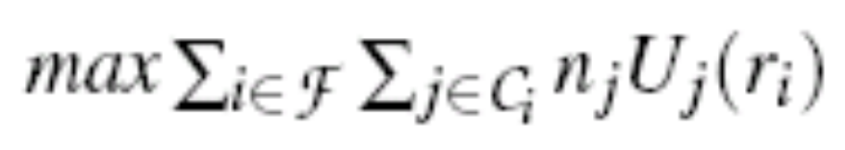
System Model - Objective
Maximize Utility:
Two sub-problems
  Rate allocation
  Consumer allocation

Slide 9
Optimization Algorithm – Key Ideas
Rate/Population separation.
Greedy population allocation: Flow rates are fixed and populations are computed with a greedy approach at each node.
Lagrangian rate allocation: Populations are fixed and rates are computed using a Lagrangian approach.
Benefit/Cost price determination: A node price is reset after consumer allocation to reflect the value of consumers that were not admitted.

Slide 10
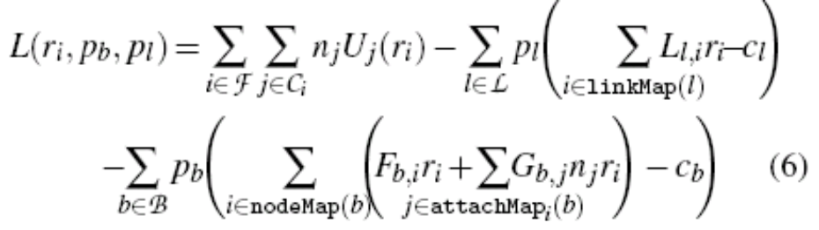
Rate Allocation
Compute a new rate for the flow, based on the feedback sent by the nodes and links visited by the flow.
It uses the Lagrangian of the original optimization problem:

Slide 11
Consumer Allocation
Allocating consumers for each flow
Use a greedy approach which sorts the consumer classes at the node in decreasing order of benefit-cost ratio.

